Slide 1
Program Soal-Soal UAS
Firnanda Pristiana Nurmaida - 1122800004

Slide 2
Program Template Matching Menggunakan SAD
import cv2
import numpy as np
def template_matching_sad_high_accuracy(image, template):
# Konversi gambar ke grayscale
gray_image = cv2.cvtColor(image, cv2.COLOR_BGR2GRAY)
gray_template = cv2.cvtColor(template, cv2.COLOR_BGR2GRAY)
# Hasil korelasi
result = cv2.matchTemplate(gray_image, gray_template, cv2.TM_SQDIFF)
# Dapatkan lokasi dengan nilai minimum
min_val, _, min_loc, _ = cv2.minMaxLoc(result)
return min_loc

Slide 3
# Baca gambar dan template
image = cv2.imread('gambar_utama.jpg') # Ganti 'gambar_utama.jpg' dengan nama gambar yang kamu gunakan
template = cv2.imread('template.jpg') # Ganti 'template.jpg' dengan nama template yang kamu gunakan
# Panggil fungsi template_matching_sad_high_accuracy
matching_loc = template_matching_sad_high_accuracy(image, template)
# Gambar hasil
result_image = image.copy()
cv2.rectangle(result_image, matching_loc, (matching_loc[0] + template.shape[1], matching_loc[1] + template.shape[0]), (0, 255, 0), 2)
# Tampilkan gambar hasil
cv2.imshow('Hasil', result_image)
cv2.waitKey(0)
cv2.destroyAllWindows()

Slide 4

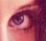
Gambar Utama
Template

Slide 5
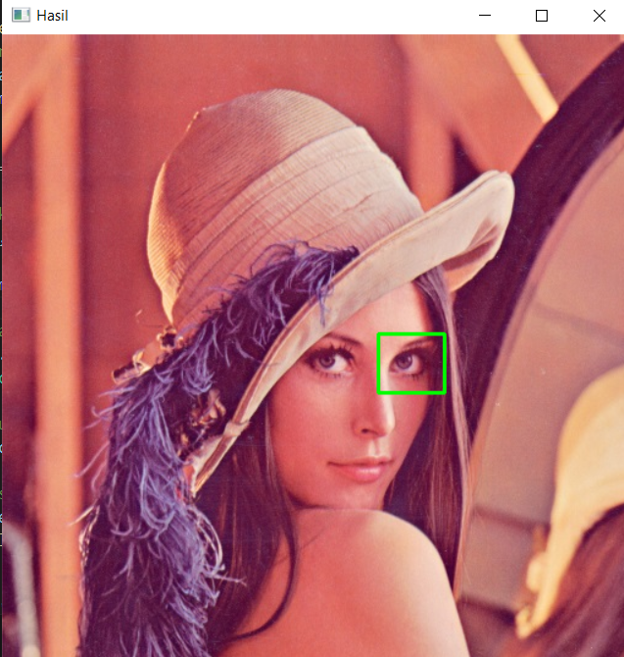
Hasil

Slide 6
Template Matching Menggunakan SSD
import cv2
import numpy as np
def template_matching_ssd(image, template):
# Konversi gambar ke grayscale
gray_image = cv2.cvtColor(image, cv2.COLOR_BGR2GRAY)
gray_template = cv2.cvtColor(template, cv2.COLOR_BGR2GRAY)
# Ukuran gambar dan template
height, width = gray_image.shape
t_height, t_width = gray_template.shape
# Inisialisasi variabel untuk menyimpan nilai minimum dan koordinat
min_diff = float('inf')
min_loc = (0, 0)

Slide 7
# Loop untuk mencari lokasi dengan perbedaan minimum
for y in range(height - t_height + 1):
for x in range(width - t_width + 1):
# Bagian dari gambar sesuai dengan ukuran template
roi = gray_image[y:y+t_height, x:x+t_width]
# Menghitung SSD
ssd = np.sum((roi - gray_template)**2)
# Memperbarui nilai minimum jika ditemukan perbedaan yang lebih kecil
if ssd < min_diff:
min_diff = ssd
min_loc = (x, y)
return min_loc
# Baca gambar dan template
image = cv2.imread('gambar_utama.jpg') # Ganti 'gambar_utama.jpg' dengan nama gambar yang kamu gunakan
template = cv2.imread('template.jpg') # Ganti 'template.jpg' dengan nama template yang kamu gunakan

Slide 8
# Panggil fungsi template_matching_ssd
matching_loc = template_matching_ssd(image, template)
# Gambar hasil
result_image = image.copy()
cv2.rectangle(result_image, matching_loc, (matching_loc[0] + template.shape[1], matching_loc[1] + template.shape[0]), (0, 255, 0), 2)
# Tampilkan gambar hasil
cv2.imshow('Hasil', result_image)
cv2.waitKey(0)
cv2.destroyAllWindows()

Slide 9
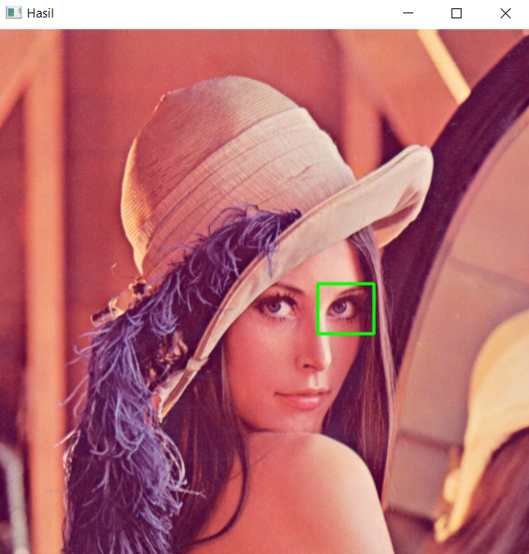
Hasil

Slide 10
Program Nomor 2 (Filter Bank)
import cv2
import numpy as np
def create_sobel_filters():
sobel_x = np.array([[-1, 0, 1],
[-2, 0, 2],
[-1, 0, 1]])
sobel_y = np.array([[-1, -2, -1],
[0, 0, 0],
[1, 2, 1]])
return sobel_x, sobel_y
def create_gaussian_filter(size, sigma=1):
filter_size = size // 2
gaussian_filter = np.zeros((size, size), dtype=np.float32)

Slide 11
for x in range(-filter_size, filter_size + 1):
for y in range(-filter_size, filter_size + 1):
gaussian_filter[x + filter_size, y + filter_size] = (1 / (2 * np.pi * sigma**2)) * \
np.exp(-(x**2 + y**2) / (2 * sigma**2))
return gaussian_filter / np.sum(gaussian_filter)
def apply_filters(image, filters):
filtered_images = []
for filter_ in filters:
filtered = cv2.filter2D(image, -1, filter_)
filtered_images.append(filtered)
return filtered_images
# Baca gambar
image = cv2.imread('gambar_utama.jpg') # Ganti 'contoh_gambar.jpg'
dengan nama gambar yang kamu gunakan
# Konversi gambar ke grayscale
gray_image = cv2.cvtColor(image, cv2.COLOR_BGR2GRAY)

Slide 12
# Buat filter bank
sobel_x, sobel_y = create_sobel_filters()
gaussian_filter = create_gaussian_filter(size=5, sigma=1)
# Gabungkan semua filter dalam satu list
filters = [sobel_x, sobel_y, gaussian_filter]
# Terapkan filter bank ke gambar
filtered_images = apply_filters(gray_image, filters)
# Menampilkan hasil
cv2.imshow('Original Image', gray_image)
for i, filtered_image in enumerate(filtered_images):
cv2.imshow(f'Filtered Image {i+1}', filtered_image)
cv2.waitKey(0)
cv2.destroyAllWindows()

Slide 13
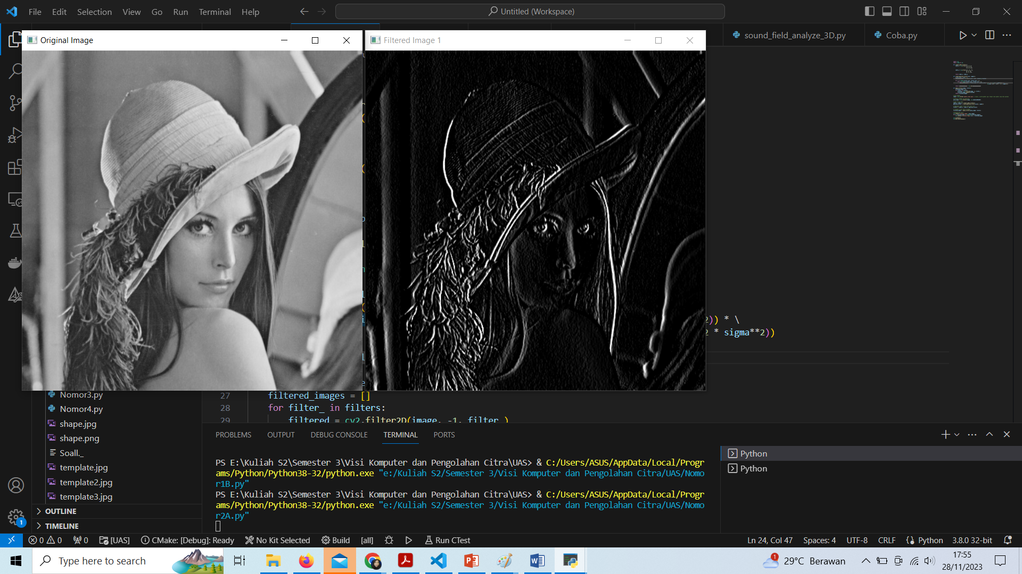
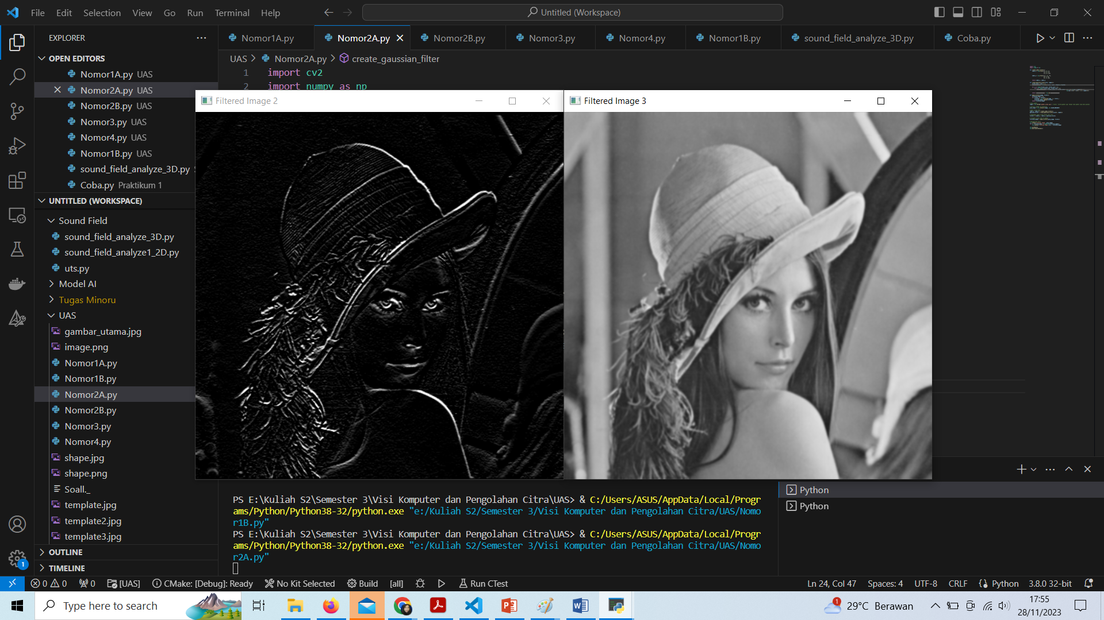
Hasil

Slide 14
Program Image Pyramid
import cv2
def image_pyramid(image, scale=0.5, min_size=(30, 30)):
yield image
while True:
width = int(image.shape[1] * scale)
height = int(image.shape[0] * scale)
image = cv2.resize(image, (width, height))
if width < min_size[0] or height < min_size[1]:
break
yield image
# Baca gambar
image = cv2.imread('gambar_utama.jpg')
# Ganti 'contoh_gambar.jpg' dengan nama gambar yang kamu gunakan

Slide 15
# Buat image pyramid dengan faktor skala 0.5
pyramid = image_pyramid(image)
# Tampilkan gambar-gambar dalam pyramid
i = 1
for resized in pyramid:
cv2.imshow(f'Layer {i}', resized)
i += 1
cv2.waitKey(0)
cv2.destroyAllWindows()

Slide 16
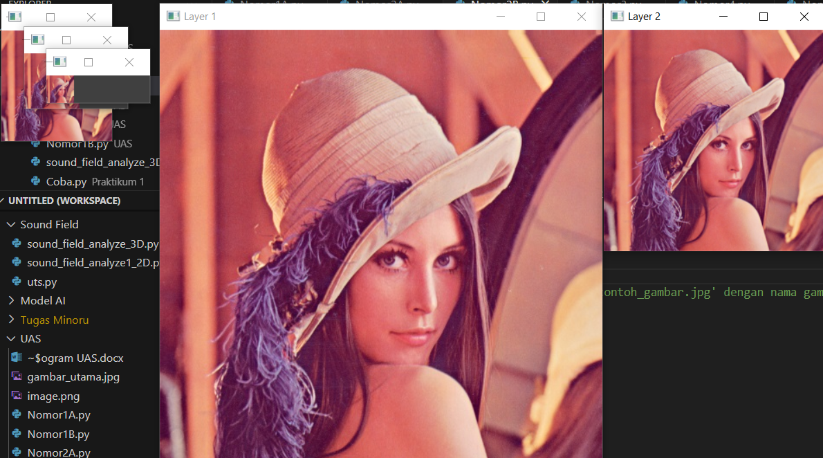
Hasil

Slide 17
Program Nomor 3 (Image Segmentation menggunakan Metode Ohlander)
import cv2
import numpy as np
def ohlander_segmentation(image, threshold):
segmented_image = np.zeros(image.shape, dtype=np.uint8)
labeled_image = np.zeros(image.shape[:2], dtype=np.uint8)
current_label = 1
for y in range(image.shape[0]):
for x in range(image.shape[1]):
if image[y, x] > threshold:

Slide 18
if y > 0 and x > 0:
if labeled_image[y-1, x] != 0:
labeled_image[y, x] = labeled_image[y-1, x]
elif labeled_image[y, x-1] != 0:
labeled_image[y, x] = labeled_image[y, x-1]
else:
labeled_image[y, x] = current_label
current_label += 1
elif y > 0:
if labeled_image[y-1, x] != 0:
labeled_image[y, x] = labeled_image[y-1, x]
else:
labeled_image[y, x] = current_label
current_label += 1
elif x > 0:
if labeled_image[y, x-1] != 0:
labeled_image[y, x] = labeled_image[y, x-1]

Slide 19
else:
labeled_image[y, x] = current_label
current_label += 1
else:
labeled_image[y, x] = current_label
current_label += 1
for y in range(image.shape[0]):
for x in range(image.shape[1]):
if labeled_image[y, x] != 0:
segmented_image[y, x] = 255
return segmented_image

Slide 20
# Baca gambar
image = cv2.imread('gambar_utama.jpg', cv2.IMREAD_GRAYSCALE) # Ganti 'contoh_gambar.jpg' dengan nama gambar yang kamu gunakan
# Tentukan nilai threshold (contohnya: 100)
threshold_value = 100
# Lakukan segmentasi menggunakan metode Ohlander
segmented_image = ohlander_segmentation(image, threshold_value)
# Tampilkan gambar hasil segmentasi
cv2.imshow('Original Image', image)
cv2.imshow('Segmented Image', segmented_image)
cv2.waitKey(0)
cv2.destroyAllWindows()

Slide 21
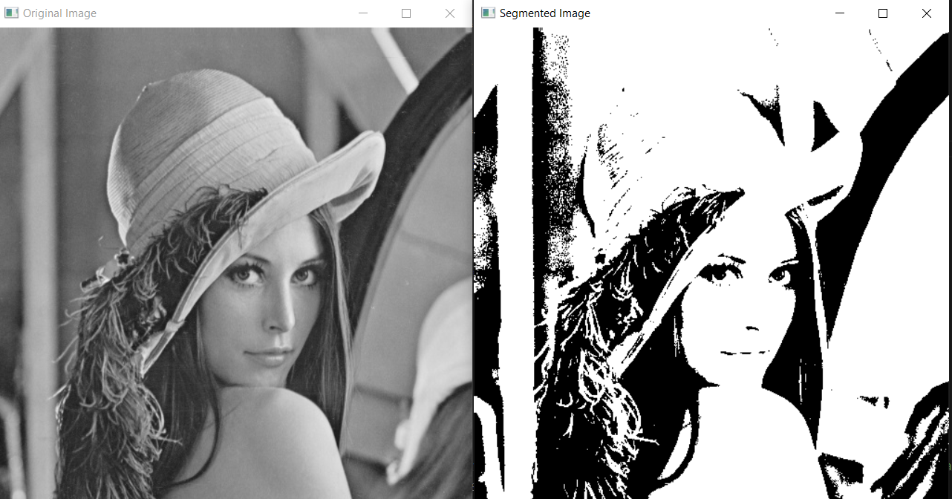
Hasil

Slide 22
Program Nomor 4 (Mendeteksi Lingkaran)
import cv2
import numpy as np
def detect_circles(image, dp=1, minDist=20, param1=50, param2=30, minRadius=0, maxRadius=0):
gray = cv2.cvtColor(image, cv2.COLOR_BGR2GRAY)
circles = cv2.HoughCircles(
gray, cv2.HOUGH_GRADIENT, dp, minDist, param1=param1, param2=param2, minRadius=minRadius, maxRadius=maxRadius
)
if circles is not None:
circles = np.uint16(np.around(circles))
for i in circles[0, :]:
center = (i[0], i[1])
radius = i[2]
cv2.circle(image, center, radius, (0, 255, 0), 2)
return image

Slide 23
# Baca gambar
image = cv2.imread('shape.jpg') # Ganti 'contoh_gambar.jpg' dengan nama gambar yang kamu gunakan
# Deteksi lingkaran dengan transformasi Hough
result_image = detect_circles(image)
# Tampilkan gambar hasil
cv2.imshow('Deteksi Lingkaran', result_image)
cv2.waitKey(0)
cv2.destroyAllWindows()

Slide 24
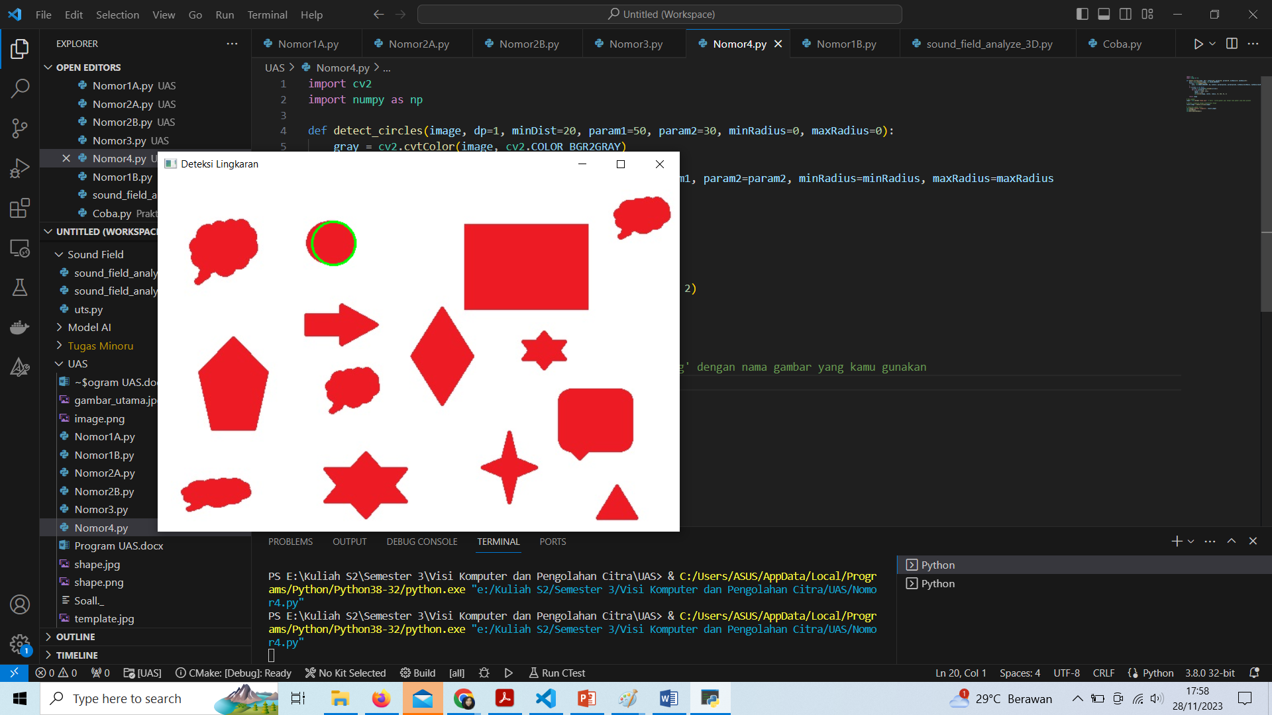
Hasil

Slide 25
Terimakasih

